Slide 1
ETL Testing
Report Testing

Slide 2
Informatica components
PowerCenter Repository
PowerCenter repository is a relational database like Oracle, Sybase, SQL server and it is managed by repository service. It consists of database tables that store metadata.
There are three Informatica Client tools available in Informatica Powercenter. They are Informatica
Designer
Workflow Monitor
Workflow Manager
These clients can access to the repository using repository service only.

Slide 3
Metadata
Informatica Metadata contains all the information about the source tables, target tables, the transformations, so that it will be useful and easy to perform transformations during the ETL process.
The term "metadata" is often used for the purpose of denoting "data about data". ... All these information is collectively called Informatica Metadata and are stored in a structured data model called Informatica Repository.

Slide 4
Informatica components
Informatica ETL tool consists of following services & components
Repository Service – Responsible for maintaining Informatica metadata & providing access of same to other services.
Integration Service – Responsible for the movement of data from sources to targets
Reporting Service - Enables the generation of reports
Nodes – Computing platform where the above services are executed
Informatica Designer - Used for creation of mappings between source and target
Workflow Manager – Used to create workflows and other task & their execution
Workflow Monitor – Used to monitor the execution of workflows
Repository Manager – Used to manage objects in repository

Slide 5
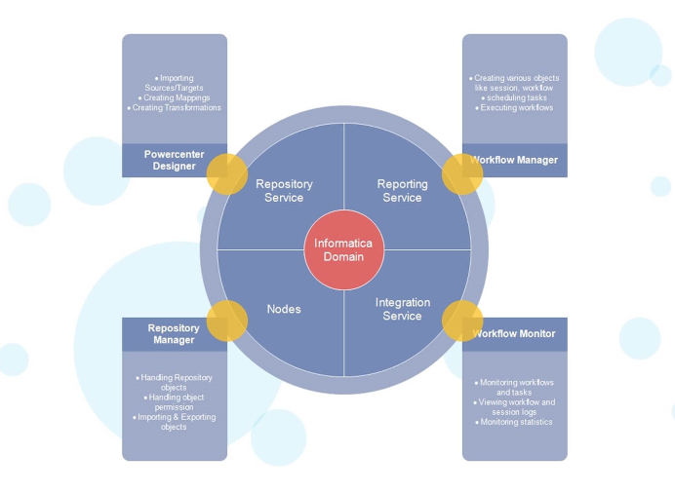
Informatica Architecture

Slide 6
Definition of informatica components
Designer :
Mapping is a collection of source and target objects linked together by a set of transformations. These transformations consist of a set of rules, which define the data flow and how the data is loaded into the targets.

Slide 7
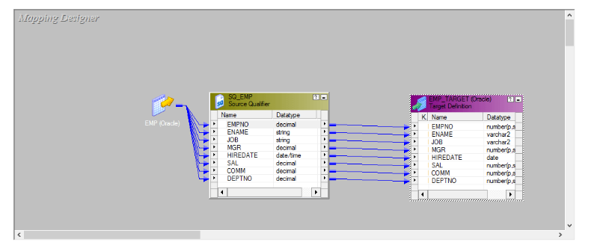
Designer

Slide 8
Workflow Manager
Informatica Workflow Manager
The Informatica Workflow Manager is used to create a Workflow. A workflow is nothing but a set of instructions to execute the Mappings that we designed in the PowerCenter Designer.
Generally, an Informatica Workflow Manager workflow contains a Session Task, Command Task, Event Wait Task, Email Task etc. It also helps you to schedule the Mappings.
Informatica PowerCenter Workflow Manager has an import option called Worklet designer, Which is used to combine (group) one or more task to make a Powerful task.

Slide 9
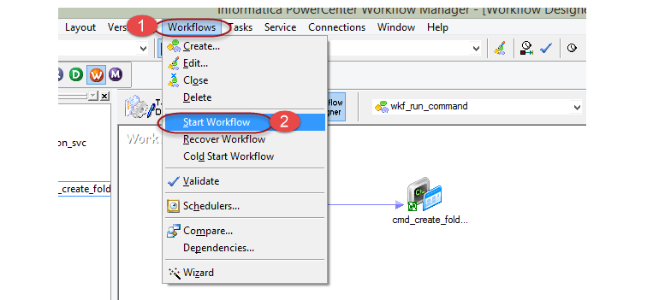
How to execute workflow

Slide 10
Workflow Monitor
Workflow monitor is a tool with the help of which you can monitor the execution of workflows and task assigned to the workflow.
In workflow monitor you can,
See the details of execution
See the history of the workflow execution
Stop, abort or restart workflows, and tasks
Display the workflows those who are executed at least one time

Slide 11
Task View
Task view displays the workflow runs in report format, and it is organized by workflow runs. It provides a convenient approach to compare workflow runs and filter details of workflow runs.
Task view shows the following details
Workflow run list – Shows the list of workflow runs. It contains folder, workflow, worklet, and task names. It displays workflow runs in chronological order with the most recent run at the top. It displays folders and Integration Services alphabetically.
Status message - Message from the Integration Service regarding the status of the task or workflow.
Node - Node of the Integration Service executed the task.
Start time - The time at which task or workflow started.
Completion time – The time at which task or workflow completed the execution.
Status - Shows status of the task or workflow, whether the workflow started, succeeded, failed or aborted.

Slide 12
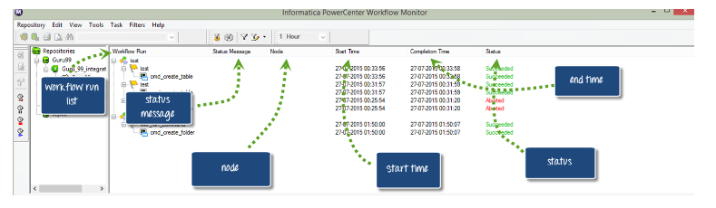
Task view Diagram

Slide 13
Gantt Chart View
In Gantt chart view, you can view chronological view of the workflow runs. Gantt chart displays the following information.
Task name – Name of the task in the workflow
Duration – The time taken to execute the task
Status – The most recent status of the task or workflow
To switch between Gantt chart and task views
To switch from Gantt chart to Task view or vice versa, click on the respective button as shown in the screenshot to change the mode.

Slide 14
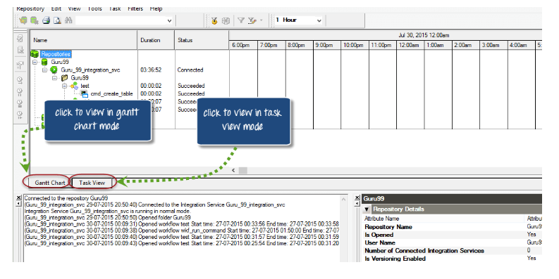
Gantt Chart View diagram

Slide 15
Definition of informatica components
Mapping:A mapping represents dataflow from sources to targets. Maplet: A mapplet creates or configures a set of transformations. Workflow:A workflow is a set of instructions that tell the Informatica server how to execute the tasks. Worklet:A worklet is an object that represents a set of tasks. Session: A session is a set of instructions to move data from sources to targets.

Slide 16
What is ETL?
ETL (Extract, Transform, and Load) Process
ETL is an abbreviation of Extract, Transform and Load. In this process, an ETL tool extracts the data from different RDBMS source systems then transforms the data like applying calculations, concatenations, etc. and then load the data into the Data Warehouse system.
It's tempting to think a creating a Data warehouse is simply extracting data from multiple sources and loading into database of a Data warehouse. This is far from the truth and requires a complex ETL process. The ETL process requires active inputs from various stakeholders including developers, analysts, testers, top executives and is technically challenging.

Slide 17
Why do you need ETL?
There are many reasons for adopting ETL in the organization:
It helps companies to analyze their business data for taking critical business decisions.
Transactional databases cannot answer complex business questions that can be answered by ETL.
A Data Warehouse provides a common data repository
ETL provides a method of moving the data from various sources into a data warehouse.

Slide 18
As data sources change, the Data Warehouse will automatically update.
Well-designed and documented ETL system is almost essential to the success of a Data Warehouse project.
Allow verification of data transformation, aggregation and calculations rules.
ETL process allows sample data comparison between the source and the target system.
ETL process can perform complex transformations and requires the extra area to store the data.
ETL helps to Migrate data into a Data Warehouse. Convert to the various formats and types to adhere to one consistent system.

Slide 19
ETL is a predefined process for accessing and manipulating source data into the target database.
ETL offers deep historical context for the business.
It helps to improve productivity because it codifies and reuses without a need for technical skills.

Slide 20
Joins
desc dept;
Name Null Type
------ -------- ------------
DEPTNO NOT NULL NUMBER(2)
DNAME VARCHAR2(14)
LOC VARCHAR2(13)
select * from dept;
DEPTNO DNAME LOC
------ -------------- -------------
10 ACCOUNTING NEW YORK
20 RESEARCH DALLAS
30 SALES CHICAGO
40 OPERATIONS BOSTON
4 rows selected

Slide 21
desc emp;
Name Null Type
-------- -------- ------------
EMPNO NOT NULL NUMBER(4)
ENAME VARCHAR2(10)
JOB VARCHAR2(9)
MGR NUMBER(4)
HIREDATE DATE SAL NUMBER(7,2)
COMM NUMBER(7,2)
DEPTNO NUMBER(2)

Slide 22
select empno, ename, job, mgr, deptno from emp;
EMPNO ENAME JOB MGR DEPTNO
----- ---------- --------- ---- ------
7839 KING PRESIDENT
7698 BLAKE MANAGER 7839 30
7782 CLARK MANAGER 7839 10
7566 JONES MANAGER 7839 20
7788 SCOTT ANALYST 7566 20
7902 FORD ANALYST 7566 20
7654 MARTIN SALESMAN 7698 30
7934 MILLER CLERK 7782 10
8 rows selected

Slide 23
Inner joins
An inner join requires each record in the two joined tables to have matching records.
select emp.ename, dept.dname from emp inner join dept on emp.deptno = dept.deptno;
Record count:7

Slide 24
---------- --------------
MILLER ACCOUNTING
CLARK ACCOUNTING
JONES RESEARCH
FORD RESEARCH
SCOTT RESEARCH
MARTIN SALES
BLAKE SALES
7 rows selected

Slide 25
Left outer join
Matched records from both the tables and unmatched records from the left side table.
Record count:8
Right outer join
Matched records from both the tables and unmatched records from the right side table.
Record count:8

Slide 26
Left outer join
ENAME DNAME
---------- --------------
MILLER ACCOUNTING
CLARK ACCOUNTING
FORD RESEARCH
SCOTT RESEARCH
JONES RESEARCH
MARTIN SALES
BLAKE SALES
KING
8 rows selected

Slide 27
Right outer join
ENAME DNAME
---------- --------------
MILLER ACCOUNTING
CLARK ACCOUNTING
JONES RESEARCH
SCOTT RESEARCH
FORD RESEARCH
MARTIN SALES
BLAKE SALES
OPERATIONS
8 rows selected

Slide 28
Full outer join
Matched records from both the tables and unmatched records from the both tables.
Record count:9
ENAME DNAME
---------- --------------
KING
BLAKE SALES
CLARK ACCOUNTING
JONES RESEARCH
SCOTT RESEARCH
FORD RESEARCH
MARTIN SALES
MILLER ACCOUNTING
OPERATIONS
9 rows selected

Slide 29
Cross join
A CROSS JOIN returns the Cartesian product of rows from tables A and B. It will produce rows which combine each row from the table A with each row from table B.
select emp.ename, dept.dname from emp cross join dept;
Total rows:32
Self join

Slide 30
select e.ename as employee, m.ename as manager from emp e join emp m on e.mgr = m.empno);
EMPLOYEE MANAGER
---------- ----------
SCOTT JONES
FORD JONES
MARTIN BLAKE
MILLER CLARK
JONES KING
CLARK KING
BLAKE KING
7 rows selected

Slide 31
SESSION
Session property is a set of instructions that instructs Informatica how and when to move the data from source to targets.
A session property is a task, just like other tasks that we create in workflow manager. Any session you create must have a mapping associated with it.
A session can have a single mapping at a time and once assigned, it cannot be changed. To execute a session task, it must be added to a workflow.
A session can be a reusable object or non-reusable. When you create a session in task developer, then it can be reused, but when you create a session in workflow designer, then it is non-reusable.
A reusable session can be added to multiple workflows.

Slide 32
Properties Of Session
Using the properties of the session you can configure various characteristics of the session like pre and post SQL scripts, log file name and path, memory properties, etc.
You can also override mapping properties in the session properties. In this section, we will discuss the following important properties of the session.
Treat source rows as
Commit Interval
Session log file Property
Test Load Property
Log options
Error Handling
Source/Target Properties
Connections
Step 1) Open the session "s_m_emp_emp_target" in task developer, which we created in the earlier tutorial.

Slide 33
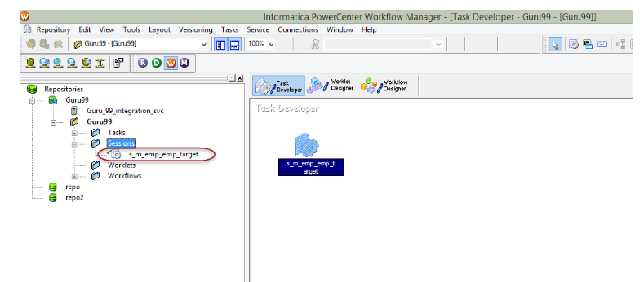

Slide 34
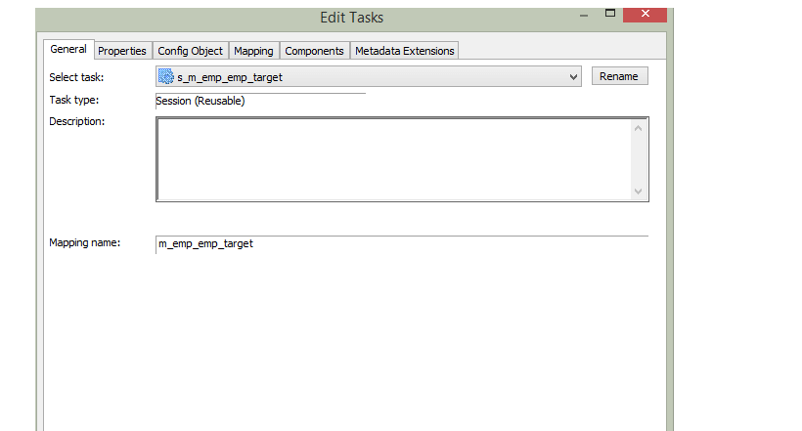
Step 2) Double click on the session icon inside Task Developer to open edit task window.

Slide 35
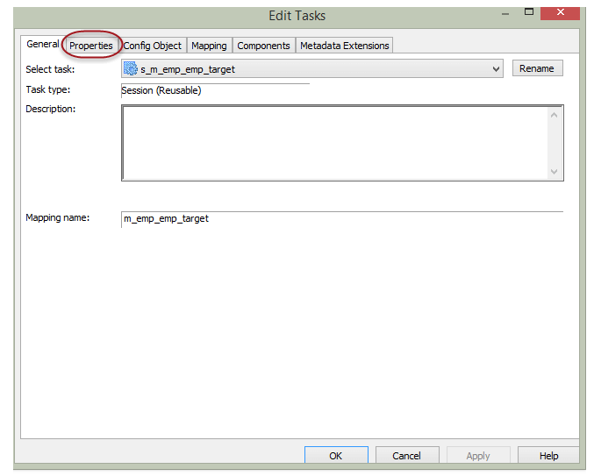
Step 3) Inside the "Edit Task" window clicks on the properties tab.

Slide 36
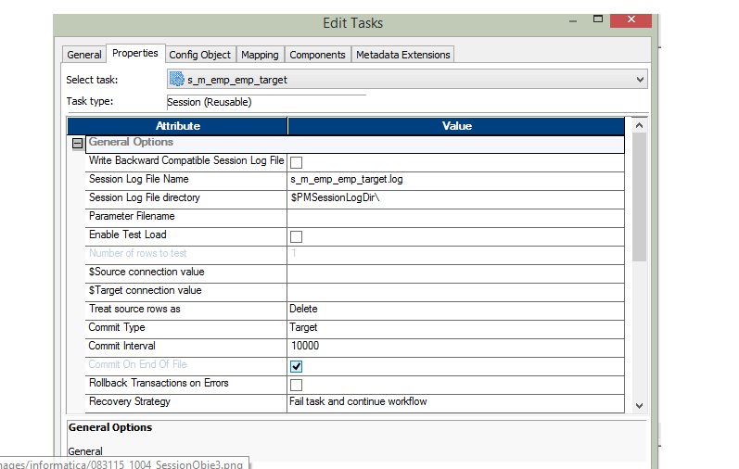
Step 4) In properties tab, it will show the properties of the session

Slide 37
Treat Source Rows As Property
This property allows you to define how the source data affects the target table. For example, you can define that the source record should be inserted or deleted from the target.
This property has four options –
Insert
Update
Delete
Data-driven

Slide 38
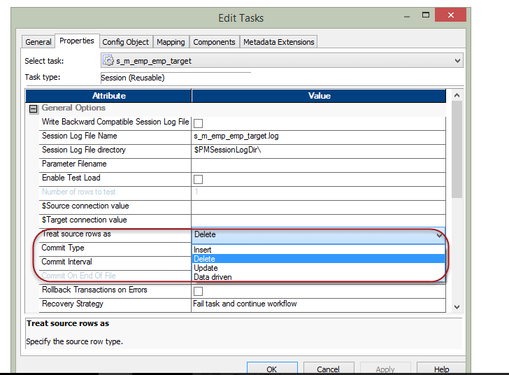

Slide 39
When this property is set to insert, the source data will be marked to be inserted. It means the data will only be inserted.
When the property is set to update, the target data will be updated by the source data. For updating of data primary key needs to be defined in the target table.
When property is set to delete the source data which is already present in the target will be deleted from the target table. For this property to execute and apply the changes, the primary key should be defined in the target table.
With the property set to data driven, the Informatica checks what source records are marked. If in a mapping the source records are marked as insert then records will be inserted into the target. If records are marked as an update in the mapping, then the records will be updated in the target. So what operation will be performed at the target depends on how records are handled inside the mapping.

Slide 40
DWH Concepts
Star and SnowFlake Schema in Data Warehousing
What is Multidimensional schemas?
Multidimensional schema is especially designed to model data warehouse systems. The schemas are designed to address the unique needs of very large databases designed for the analytical purpose (OLAP).
Types of Data Warehouse Schema:
Following are 3 chief types of multidimensional schemas each having its unique advantages.
Star Schema
Snowflake Schema
Galaxy Schema

Slide 41
What is a Star Schema?
The star schema is the simplest type of Data Warehouse schema. It is known as star schema as its structure resembles a star. In the Star schema, the center of the star can have one fact tables and numbers of associated dimension tables. It is also known as Star Join Schema and is optimized for querying large data sets.
For example, as you can see in the above-given image that fact table is at the center which contains keys to every dimension table like Deal_ID, Model ID, Date_ID, Product_ID, Branch_ID & other attributes like Units sold and revenue.

Slide 42
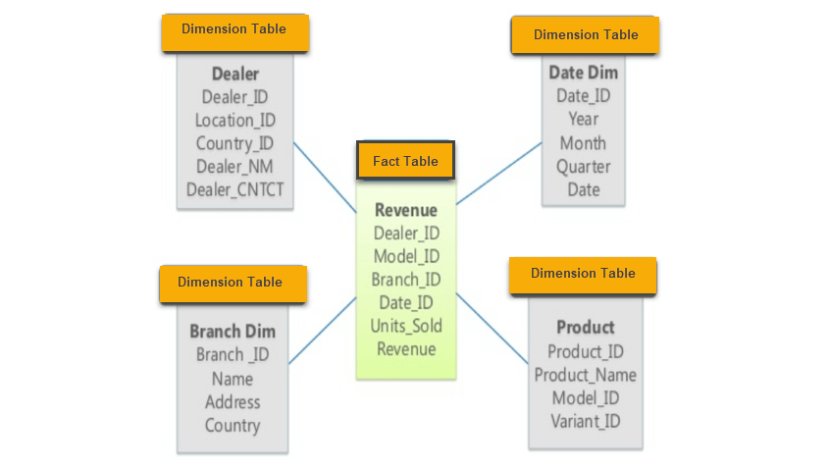

Slide 43
Characteristics of Star Schema:
Every dimension in a star schema is represented with the only one-dimension table.
The dimension table should contain the set of attributes.
The dimension table is joined to the fact table using a foreign key
The dimension table are not joined to each other
Fact table would contain key and measure
The Star schema is easy to understand and provides optimal disk usage.
The dimension tables are not normalized. For instance, in the above figure, Country_ID does not have Country lookup table as an OLTP design would have.
The schema is widely supported by BI Tools

Slide 44
What is a Snowflake Schema?
A Snowflake Schema is an extension of a Star Schema, and it adds additional dimensions. It is called snowflake because its diagram resembles a Snowflake.
The dimension tables are normalized which splits data into additional tables. In the following example, Country is further normalized into an individual table.

Slide 45
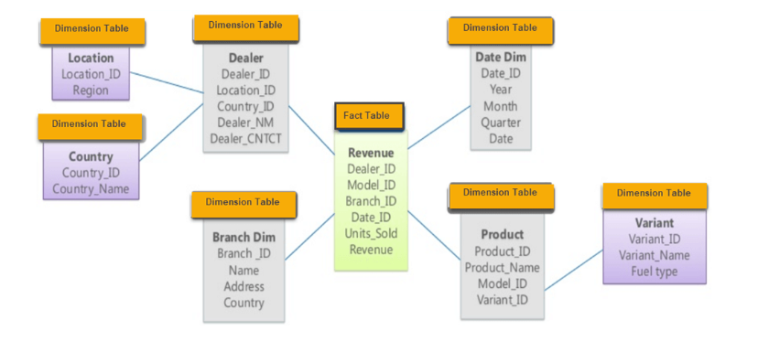

Slide 46
Characteristics of Snowflake Schema:
The main benefit of the snowflake schema it uses smaller disk space.
Easier to implement a dimension is added to the Schema
Due to multiple tables query performance is reduced
The primary challenge that you will face while using the snowflake Schema is that you need to perform more maintenance efforts because of the more lookup tables.

Slide 47
Star Vs Snowflake Schema: Key Differences
Star Schema Snow Flake Schema
Hierarchies for the dimensions are stored in the dimensional table. | Hierarchies are divided into separate tables.
It contains a fact table surrounded by dimension tables. | One fact table surrounded by dimension table which are in turn surrounded by dimension table
In a star schema, only single join creates the relationship between the fact table and any dimension tables. | A snowflake schema requires many joins to fetch the data.
Simple DB Design. | Very Complex DB Design.
Denormalized Data structure and query also run faster. | Normalized Data Structure.

Slide 48
High level of Data redundancy | Very low-level data redundancy
Single Dimension table contains aggregated data. | Data Split into different Dimension Tables.
Cube processing is faster. | Cube processing might be slow because of the complex join.
Offers higher performing queries using Star Join Query Optimization. Tables may be connected with multiple dimensions. | The Snow Flake Schema is represented by centralized fact table which unlikely connected with multiple dimensions.

Slide 49
What is a Galaxy schema?
A Galaxy Schema contains two fact table that shares dimension tables. It is also called Fact Constellation Schema. The schema is viewed as a collection of stars hence the name Galaxy Schema.
As you can see in above figure, there are two facts table
Revenue
Product.
In Galaxy schema shares dimensions are called Conformed Dimensions

Slide 50
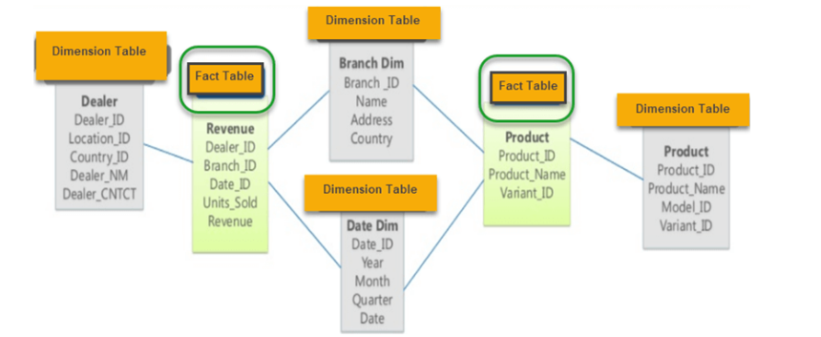

Slide 51
Characteristics of Galaxy Schema:
The dimensions in this schema are separated into separate dimensions based on the various levels of hierarchy.
For example, if geography has four levels of hierarchy like region, country, state, and city then Galaxy schema should have four dimensions.
Moreover, it is possible to build this type of schema by splitting the one-star schema into more Star schemes.
The dimensions are large in this schema which is needed to build based on the levels of hierarchy.
This schema is helpful for aggregating fact tables for better understanding.

Slide 52
Data Modeling - Conceptual, Logical, And Physical Data Models
The three levels of data modeling, conceptual data model, logical data model, and physical data model, were discussed in prior sections. Here we compare these three types of data models. The table below compares the different features:
An entity is any object in the system that we want to model and store information about. Entities are usually recognizable concepts, either concrete or abstract, such as person, places, things, or events which have relevance to the database. Some specific examples of entities are Employee, Student, Lecturer.

Slide 54
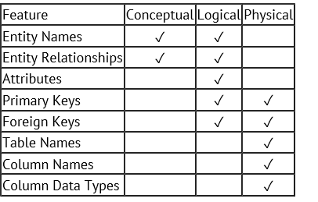
Attribute is the characteristic property of an existing entity.

Slide 55
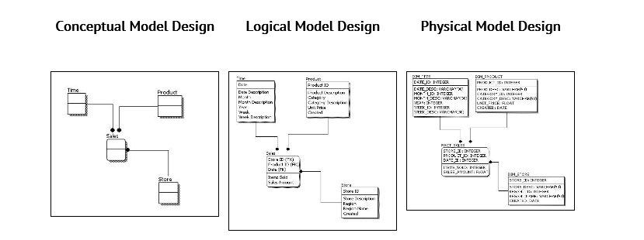
Below we show the conceptual, logical, and physical versions of a single data model.

Slide 56
We can see that the complexity increases from conceptual to logical to physical. This is why we always first start with the conceptual data model (so we understand at high level what are the different entities in our data and how they relate to one another), then move on to the logical data model (so we understand the details of our data without worrying about how they will actually implemented), and finally the physical data model (so we know exactly how to implement our data model in the database of choice). In a data warehousing project, sometimes the conceptual data model and the logical data model are considered as a single deliverable.

Slide 57
Difference between ODS and EDW
An ODS is meant for operational reporting and supports current or near real-time reporting requirements whereas a data warehouse is meant for historical and trend analysis reporting usually on a large volume of data. An ODS contains only a short window of data, while a data warehouse contains the entire history of data.

Slide 58
